Slide 1
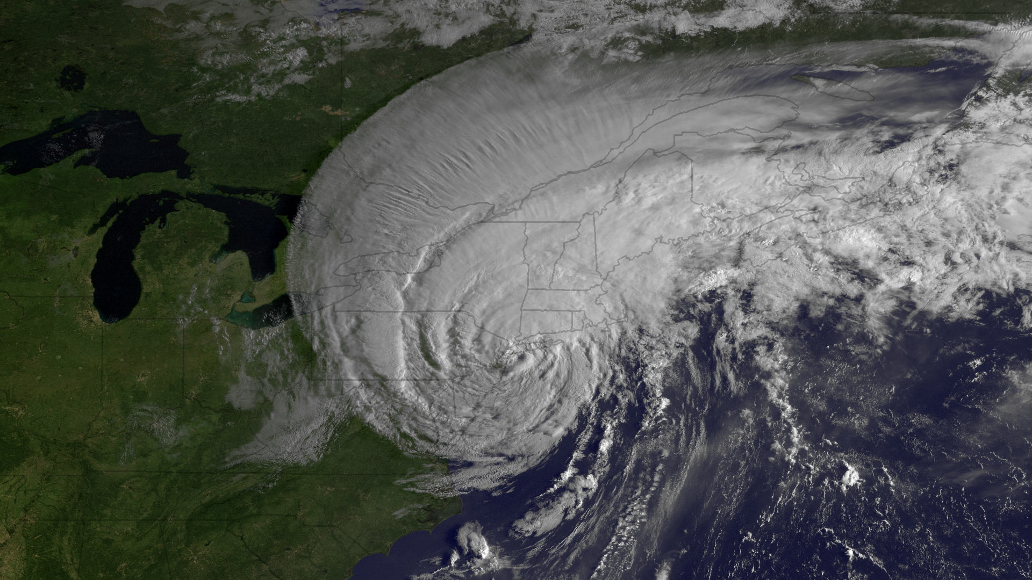


ATM505: Atmospheric Physics II
Introduction to the Course and ASRC
Chris Thorncroft
Jeff Freedman
Jie Zhang
Fangqun Yu
Sara Lance
Wednesday, January 18th, 2023

Slide 2
INTRODUCTIONS

Slide 3

SYLLABUS for ATM505

Slide 4
ATM 505 INTRODUCTION TO ATMOSPHERIC PHYSICS II
Instructor: Chris Thorncroft cthorncroft@albany.edu
Office Hours: Email for appointment
Instructor: Jeff Freedman jfreedman@albany.edu
Instructor: Jie Zhang jzhang35@albany.edu
Instructor: Fangqun Yu fyu@albany.edu
Instructor: Sara Lance smlance@albany.edu
Office Hours for instructors will be provided at the beginning of each Module
Lecture Times: Mon and Wed 3.00pm-4.20pm
Location: ETEC 482
Credits: 3
Prerequisite for Course: ATM504
Grading Scheme: Graded

Slide 5
Aims of Course:
The course aims to expose students to the application of physical laws and principles in the following 4 fundamental areas:
Planetary boundary layer
Atmospheric Chemistry
Aerosols
Cloud Microphysics
The course is, by definition, introductory with the goal of exposing students to different areas of atmospheric physics.
Course Assessment:
1. First Exam Modules (1-2) March 6th (in class time) 34%
2. Four problem sets Given one week to do them (8% each) 32%
3. Second exam Modules (3-4) May 9th (3.30pm-5.30pm) 34%

Slide 6
Homework policy
Each Module has a homework. You have 1 week to complete and hand them in by the end of the class that they are due in.
LATE HOMEWORK will incur a penalty of 15% per day unless there is a documented and legitimate reason such as a health issue or travel to a conference or fieldwork etc. Homework will not be accepted after the answers have been graded and returned to the rest of the class.
Academic integrity
We encourage an atmosphere of open inquiry and mutual respect. While collaborations with fellow students on homework is permissible you must always submit your own work and your own thoughts, and give proper credit to others for previous work and ideas. Every student must be familiar with the standards of academic integrity at UAlbany. Claims of ignorance, of unintentional error, or of academic or personal pressures are not sufficient reasons for violations of academic integrity. Please review these policies in the Graduate Bulletin at http://www.albany.edu/graduatebulletin/requirements_degree.htm
Textbook
There is no recommended textbook for this course. Recommended reading will be made by instructors as appropriate

Slide 7
ATM 505
Boundary Layer
Jeff Freedman
ASRC
jfreedman@albany.edu

Slide 8
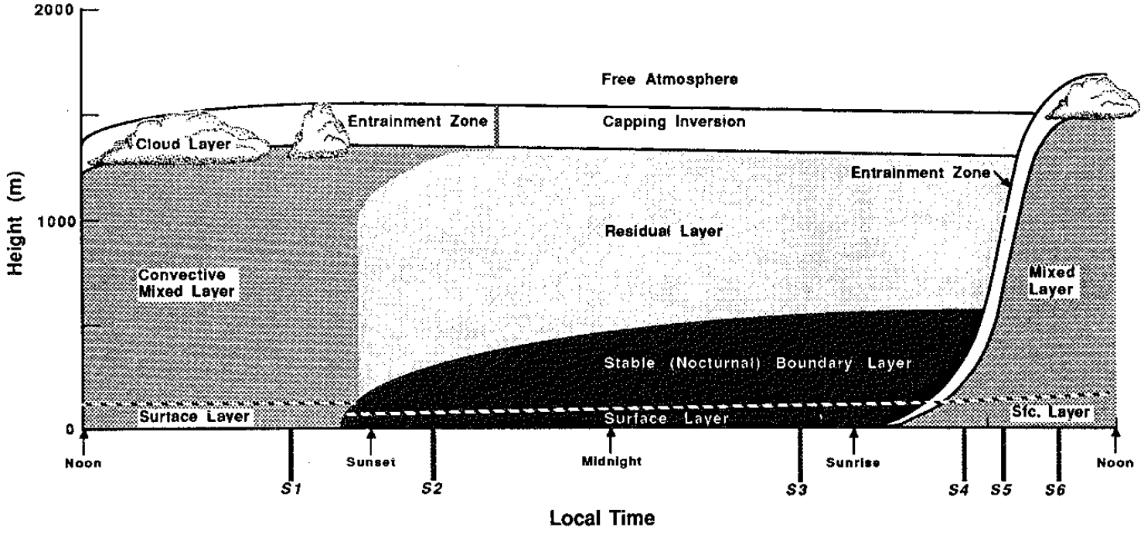
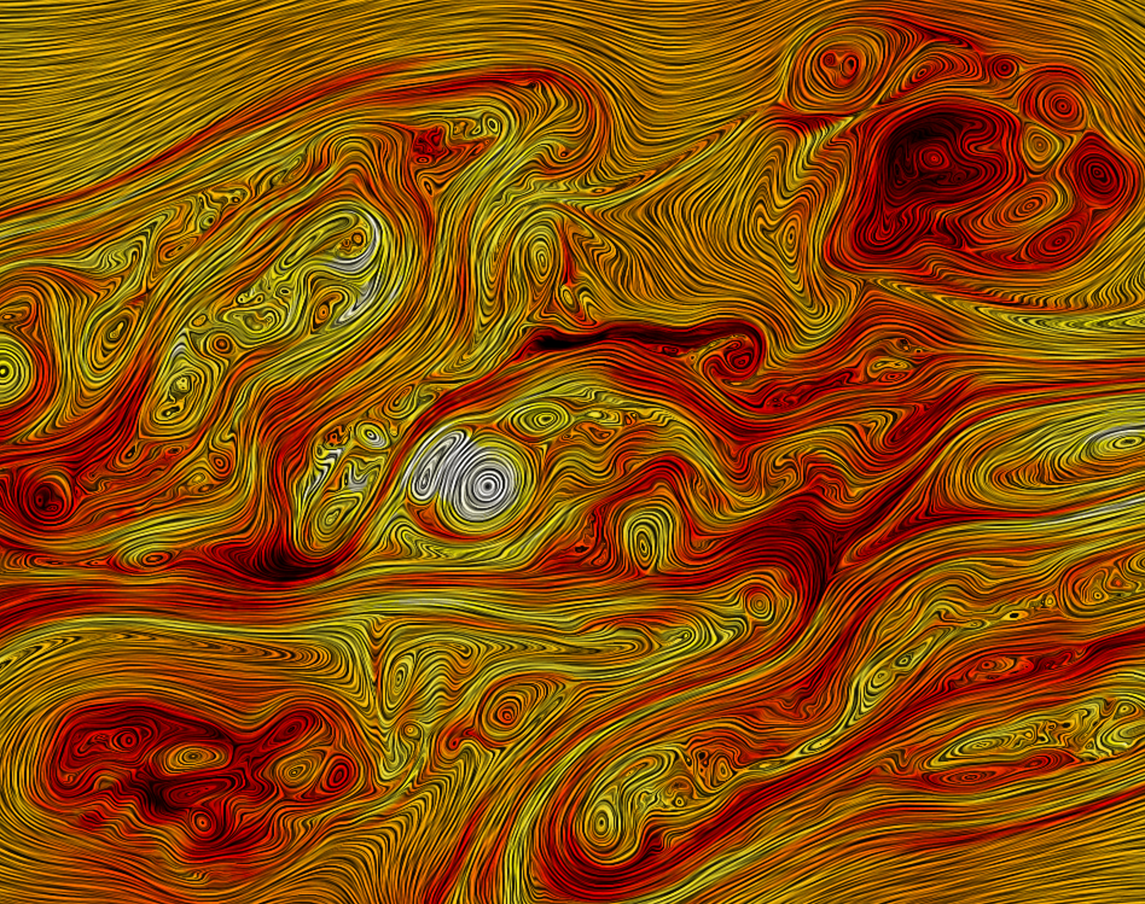
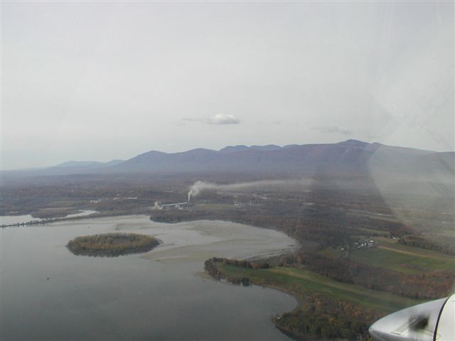
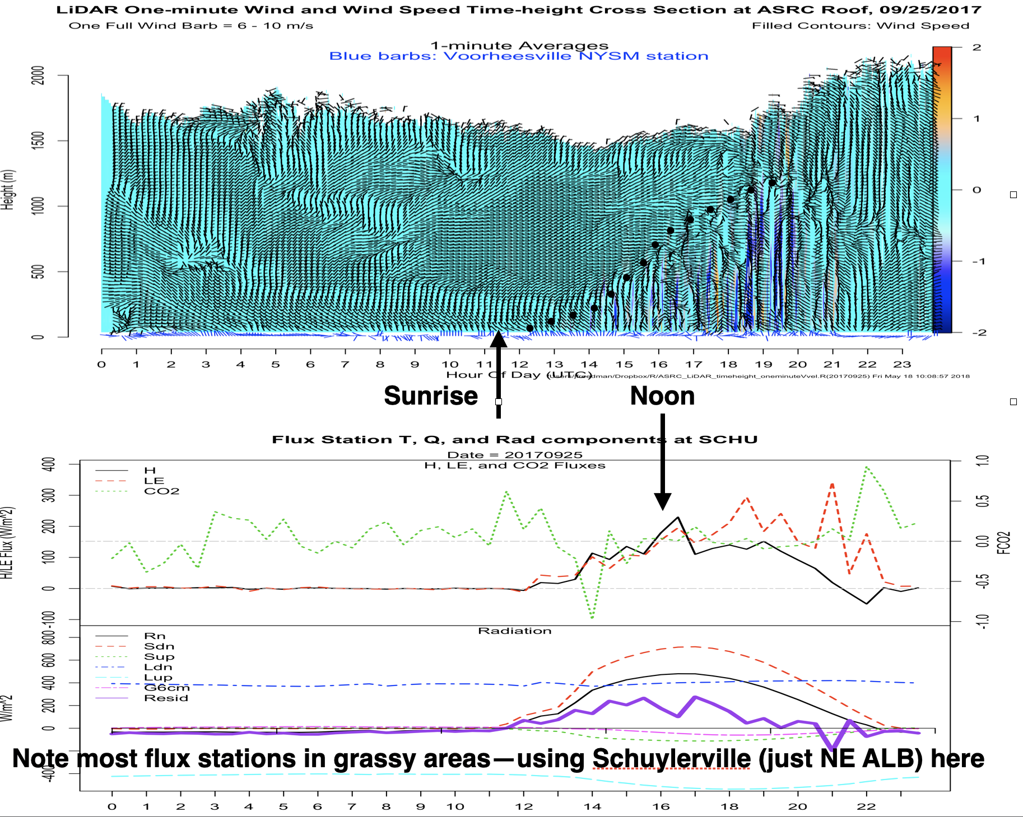
AATM 505—Boundary Layer Meteorology Module
Course Outline
Lecture 1: Introduction to the Atmospheric Boundary Layer (ABL)
Lecture 2: Turbulence—scales, measurements
Lecture 3: Stability—types, measurements, indices
Lecture 4: Surface Parameterizations—empirical relationships and measurements—surface fluxes
Lecture 5: Offshore (Marine) Boundary Layer [air-sea interactions]

Slide 9
AATM 505—Boundary Layer Meteorology Module
Introduction to the ABL
Definition of ABL
Coupling between ABL and surface
Approach to understanding ABL
Observing the ABL
Introduction to the New York State Mesonet
Figure from Still (1988) Chapter 1

Slide 10
AATM 505—Boundary Layer Meteorology Module
Turbulence—scales, measurements
Spectral Gap
Taylor’s Hypothesis
Fluxes
Turbulent scales
Reynold’s averaging
Measurements

Slide 11
AATM 505—Boundary Layer Meteorology Module
Stability—types, measurements, indices
Stability within the BL and diurnal cycle
Richardson number
Obukhov length
Diabatic wind profile
Photo: Tom Drew, Wyoming King Air during Hudson Valley Ambient Meteorology Study—near Athens NY.

Slide 12
AATM 505—Boundary Layer Meteorology Module
Lecture 4: Surface Parameterizations—empirical relationships and measurements—surface fluxes (putting it all together)
Bulk aerodynamic formulas
NYS Mesonet measurements
    Surface fluxes
    Profilers
      Wind
      Temperature, moisture
Freedman and Fitzjarrald (2018 AMS Boundary Layers and Turbulence Symposium)

Slide 13
AATM 505—Boundary Layer Meteorology Module
Lecture 5: Offshore (Marine) Boundary Layer [air-sea interactions]
Marine ABL
Compare and contrast with land-based ABL
Air-sea interaction
Sea breeze circulation
Offshore wind energy
From DOE NREL

Slide 14
ATM 505
Atmospheric Chemistry
Jie Zhang
ASRC
jzhang34@albany.edu

Slide 15
Atmospheric Chemistry
Study composition and chemistry of the atmosphere
More specifically, the sources, sinks, and transformations of reactive species
Reactive gases and particles are a very small fraction of the atmospheric mass (and volume)
How important can these “trace” reactive species be?

Slide 16
Examples of the Impact of Chemistry
Ozone, mainly in the stratosphere, has a mole fraction and mass fraction up to about 10 ppm, but makes human life on the surface possible by absorbing nearly all harmful UV radiation.
Surprisingly, Ozone at the surface, with concentrations typically less than 0.1 ppmv, is harmful to humans.
Particulate Matter (PM or aerosols) at the surface, is also harmful to human health at levels down to 0.01 ppmm
Other impacts on Climate, Acid Rain, ecosystem damage, etc.

Slide 17
Unit Outline
Stratospheric Chemistry (including the Antarctic Ozone Hole)
Tropospheric Gas Phase Chemistry
Aqueous Atmospheric Chemistry and Acid Rain
Aerosol Chemistry
Atmospheric Chemistry Measurements

Slide 18
ATM 505
Atmospheric Aerosols
Fangqun Yu
ASRC
fyu@albany.edu

Slide 19

Importance of Atmospheric Aerosols
1. Aerosol-cloud-radiation-precipitation interactions, and thus climate forcing and the hydrological cycle.
From https://www.pnnl.gov/news/release.aspx?id=4489

Slide 20
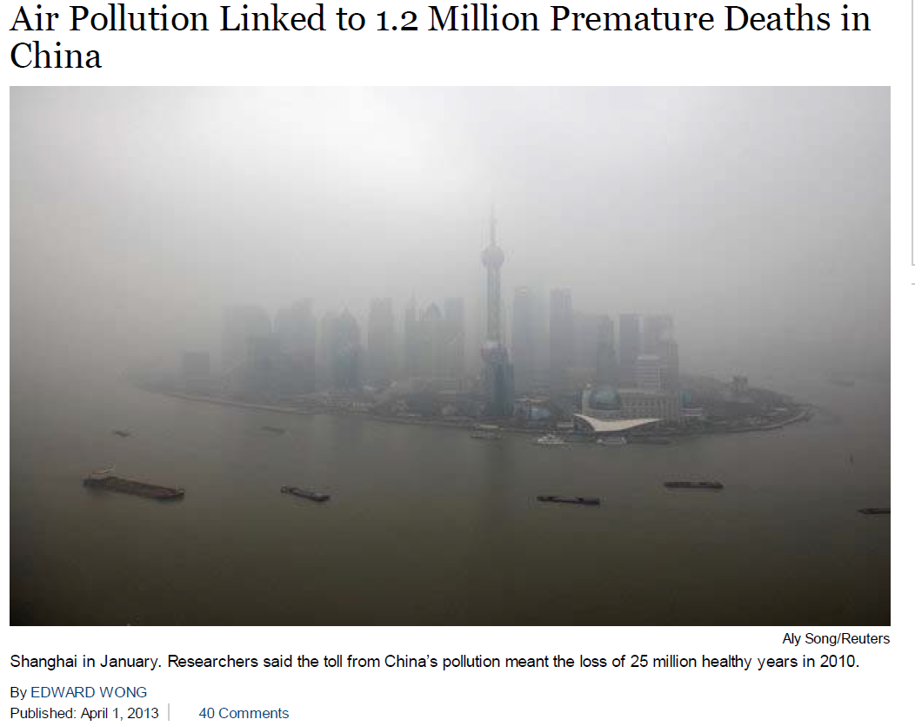

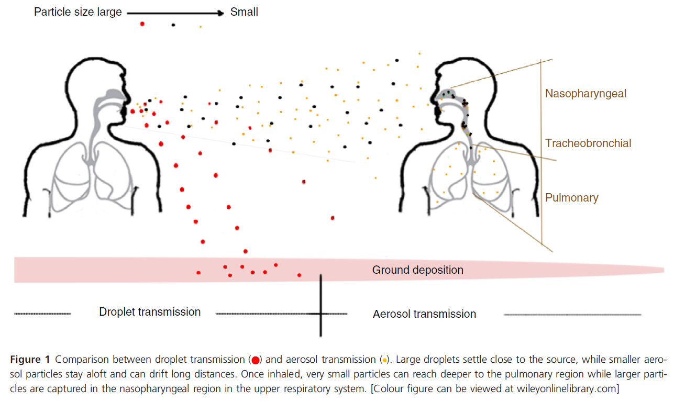
Importance of Atmospheric Aerosols
2. Role in air quality (including virus transmission, etc.), and therefore public health and morbidity.
Does aerosol transmission of coronavirus occur?
April 1, 2013
Based on a Study published in The Lancet.
From Pan et al., JAM, 2019

Slide 21
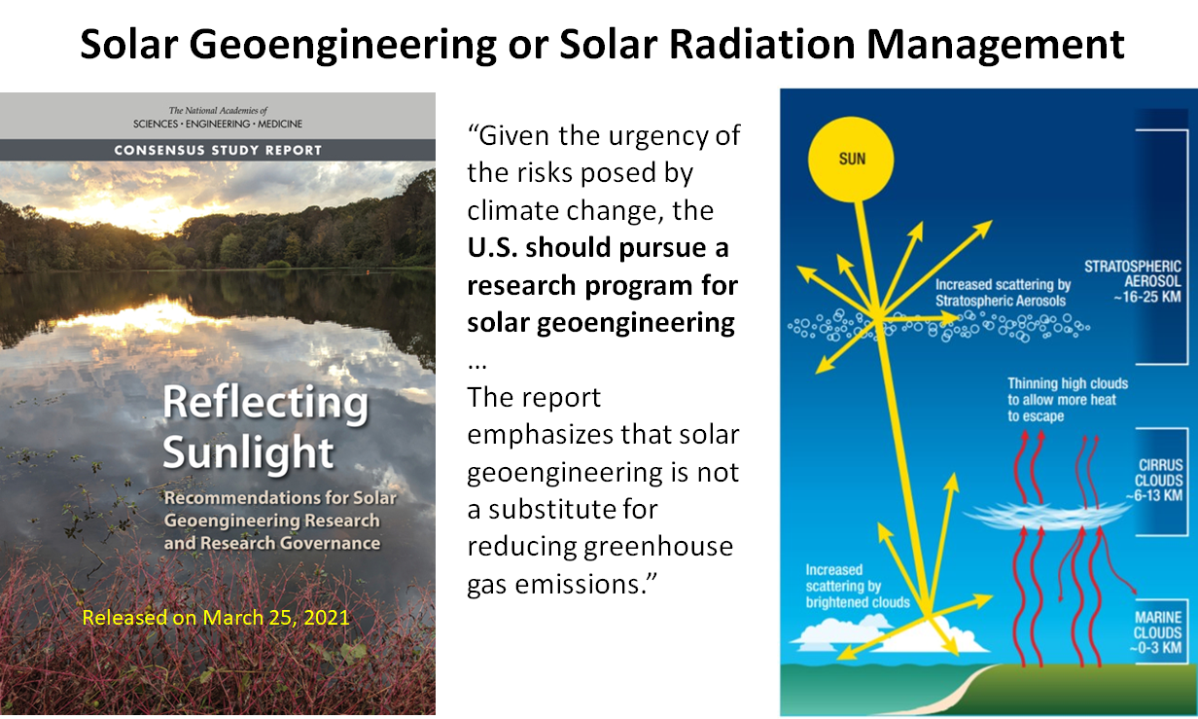

Slide 22
Unit Outline
Introduction and Aerosol Characterization
Particle Microphysics Overview and Thermodynamics
New Particle Formation and Ultrafine Particles
Aerosol Growth, Coagulation, and Deposition
Environmental and Climatic Impacts of Atmospheric Aerosols

Slide 23
ATM 505
Cloud Microphysics
Sara Lance
ASRC
smlance@albany.edu

Slide 24
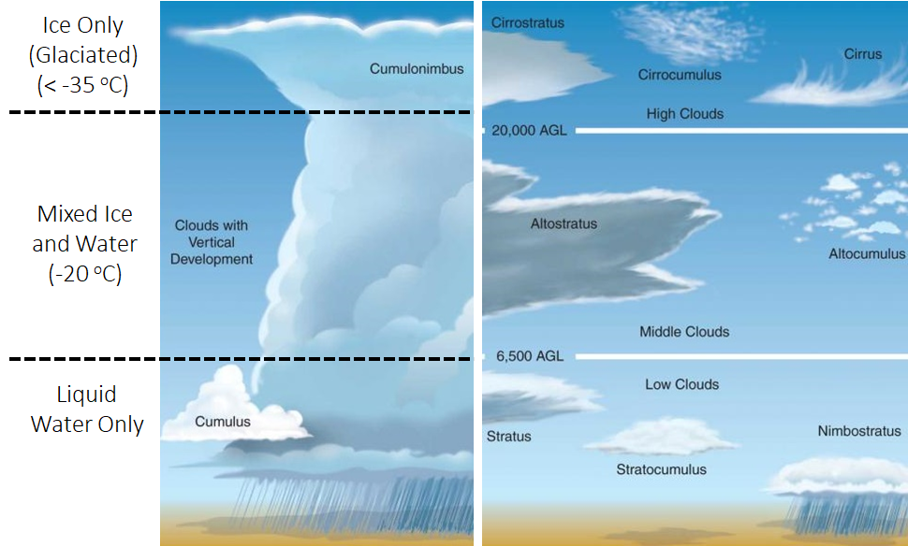
Cloud Microphysics Unit Outline
Cloud-aerosol interactions are a vital link in the global climate and water cycle. Emphasis will be on the basic microphysical processes that are involved in the formation and growth of cloud droplets and precipitation particles, making a distinction between warm clouds (temperatures > 0ºC, liquid droplets only) and cold clouds (temperatures < 0ºC, both ice and liquid particles may exist). Topics include nucleation, condensation and ice crystal growth (vapor deposition).
Lecture 1: Overview of Cloud Microphysics​
Lecture 2: Cloud Droplet Formation (Nucleation) and Condensation Growth
Lecture 3: Cloud Supersaturation and Warm Rain Process (Collision-Coalescence)
Lecture 4: Overview of Cold Cloud Processes & Ice Nucleation Modes
Lecture 5: Vapor Diffusional Growth and Ice Crystal Habit Effects​

Slide 25
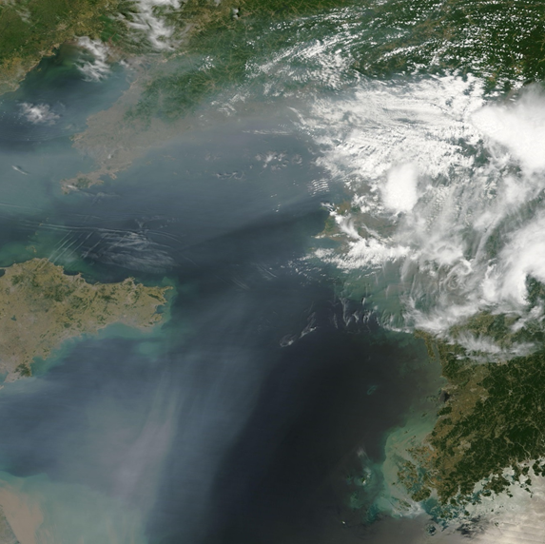
Lecture 1: Overview of Cloud Microphysics
Continuum between aerosols and clouds
Why we care about cloud microphysics
Why we care about cloud-aerosol interactions

Slide 26

Lecture 2: Cloud Droplet Formation (Nucleation) and Condensational Growth
Isobaric vs. Adiabatic generation of excess vapor
Derivation of the Kohler Curve (Saturation vapor pressure of a solution droplet)
Hygroscopicity versus cloud droplet activation
Condensational growth rate

Slide 27

Lecture 3: Cloud Supersaturation and Warm Rain Process (Collision-Coalescence)
Feedbacks between the water vapor supersauration and droplet growth
Interactions between cloud droplets
Autoconversion process and Giant Cloud Condensation Nuclei

Slide 28
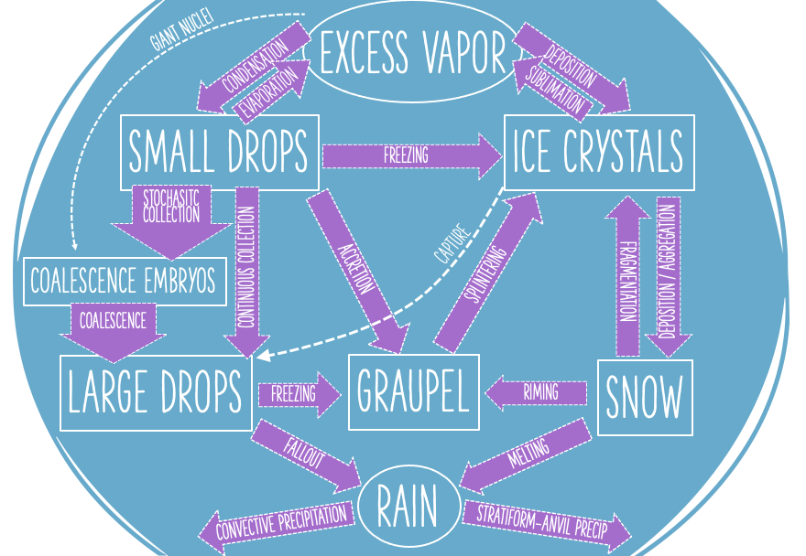
Lecture 4: Overview of Cold Cloud Processes & Ice Nucleation Modes
Differences between warm and cold cloud particles
Mixed-phase cloud processes
Modes of ice nucleation

Slide 29
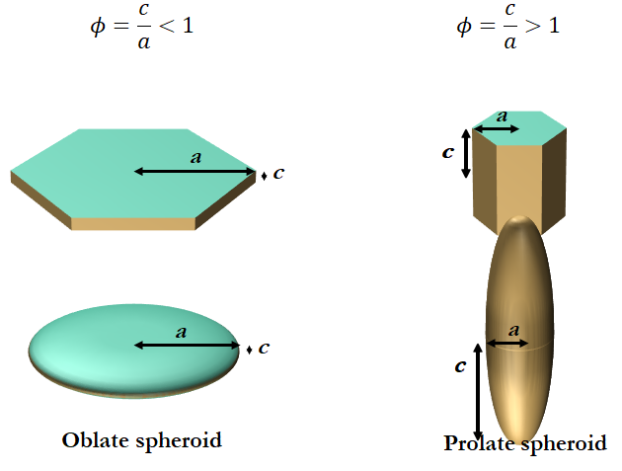
Lecture 5: Vapor Diffusional Growth and Ice Crystal Habit Effects
Simplifications to ice crystal habit
Ice crystal growth by vapor diffusion accounting for simplified particle shape (aspect ratio)
Bergeron process (interactions between particles through effects on water vapor concentrations)

Slide 30
SCHEDULE

Slide 31
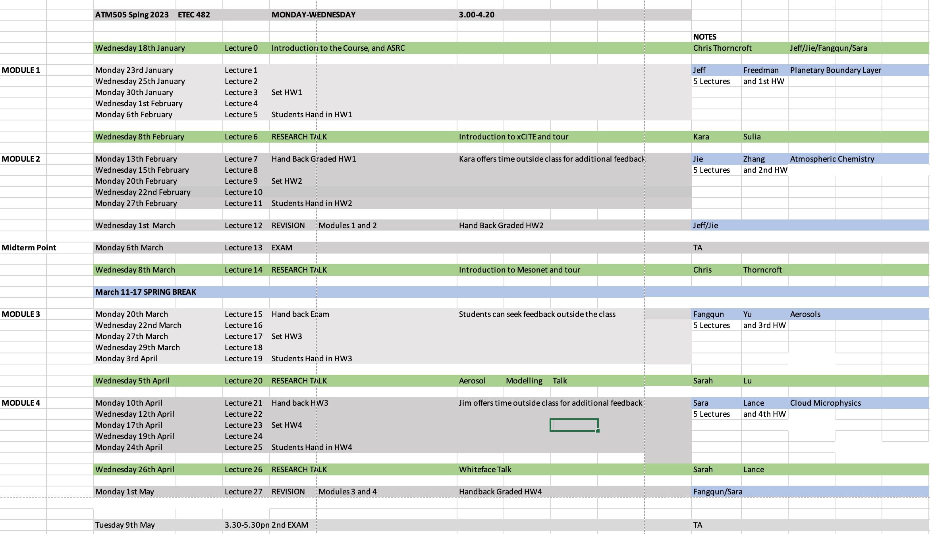

Slide 32

Introduction to ASRC and Related Projects

Slide 33

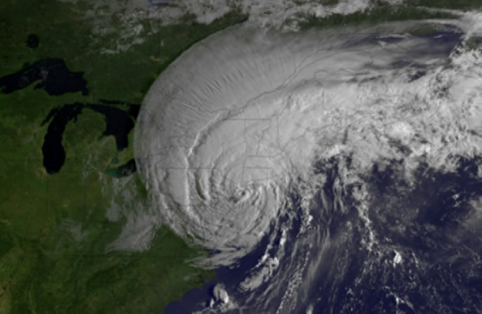
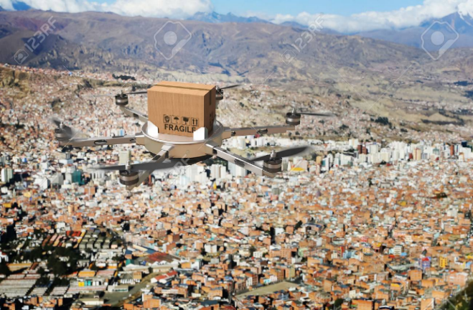

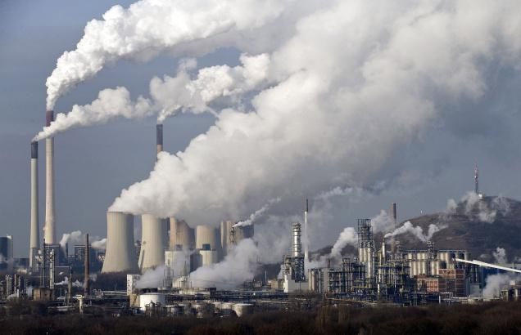
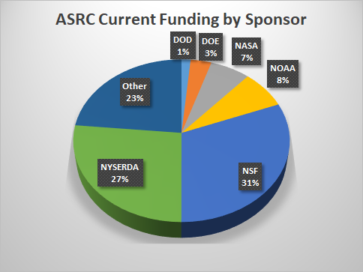
ASRC: Research Areas and Funding
Renewable Energy (Wind & Solar)
  Resource assessment
  Forecasting
  Sensor development and technology transfer
Weather and Climate
  Regional climate modeling,
  Cloud and aerosol processes, sensor development, Carbon cycle, remote sensing, Extremes
Boundary Layer Meteorology
  Forest ecosystems
  Air-sea interactions
  Land-atmosphere interactions
  PBL, turbulence, etc. F’casting for UAVs
Applications of AI/ML
Multidisciplinary Research
Development of Applications
Air Quality and Atmospheric Chemistry
  Monitoring strategies,
  Modeling (AQ, processes), Sensors
44 Active Awards with total funding of $24M

Slide 34
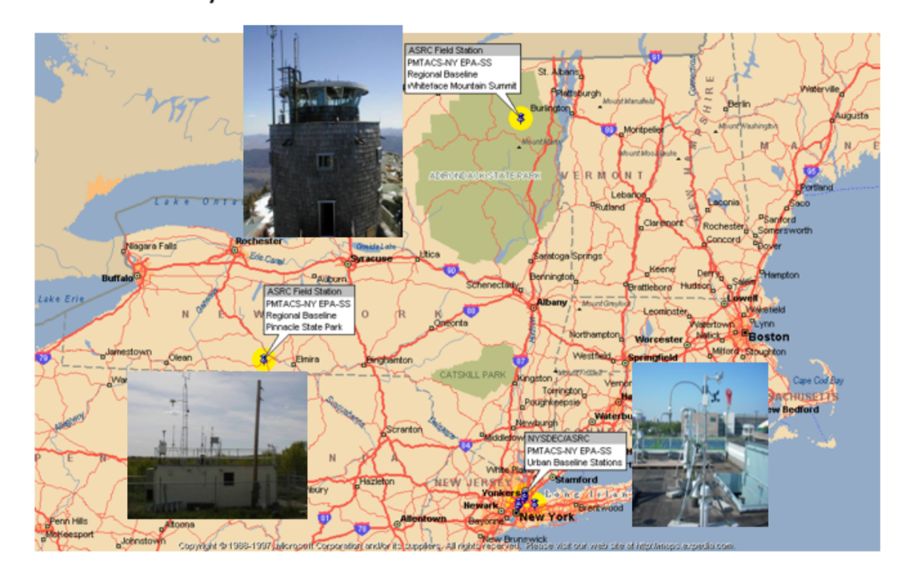
ASRC: Research Facilities
CESTM (UAlbany)
Long term research stations in the Adirondacks (Whiteface Mountain)
SW New York State (Pinnacle State Park)
Queens College
xCITE laboratory (in support of AI/ML applications)

Slide 35

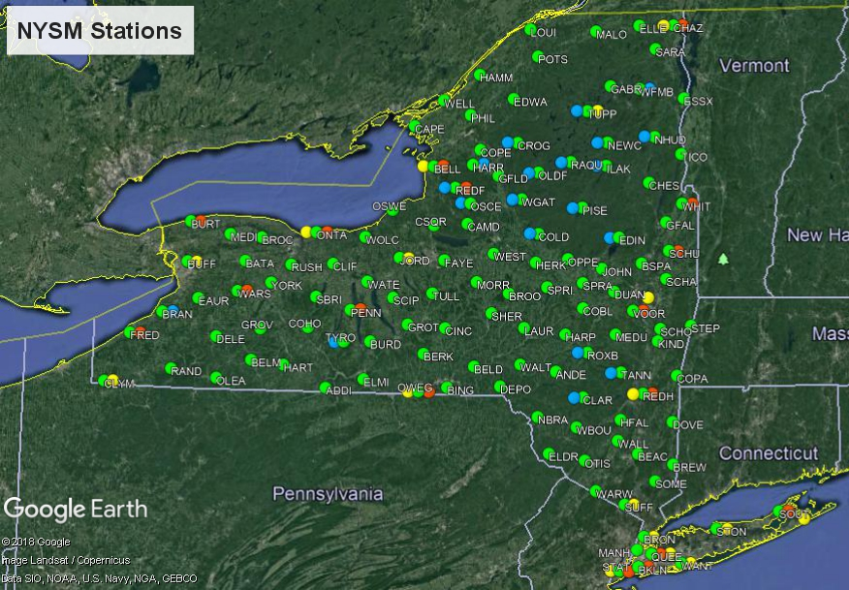

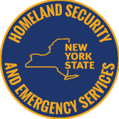
NY State Mesonet
  THE NATION’S NEW GOLD STANDARD!
At least 1 station per county
Spaced ~17 miles apart
Reports every 5 minutes
Over one billion observations archived to date

Slide 36



Center of Excellence
$8.0 Trillion or 39% of total US GDP is estimated to have weather sensitivity.
UALBANY OFFERS SOLUTIONS.
Big Data
Research
Solutions
“Largest & Most Advanced in Nation”
120 Atmospheric Researchers
Weather & Climate
Analytics CoE
PUBLIC/PRIVATE SOLUTIONS
Atmospheric Sciences
Research Center
xCITE Lab
Visual Analytics
Advanced Weather
Network
Calibration
Lab
Whiteface Mtn
Observatory
Department of Atmospheric & Environmental Sciences

Slide 37

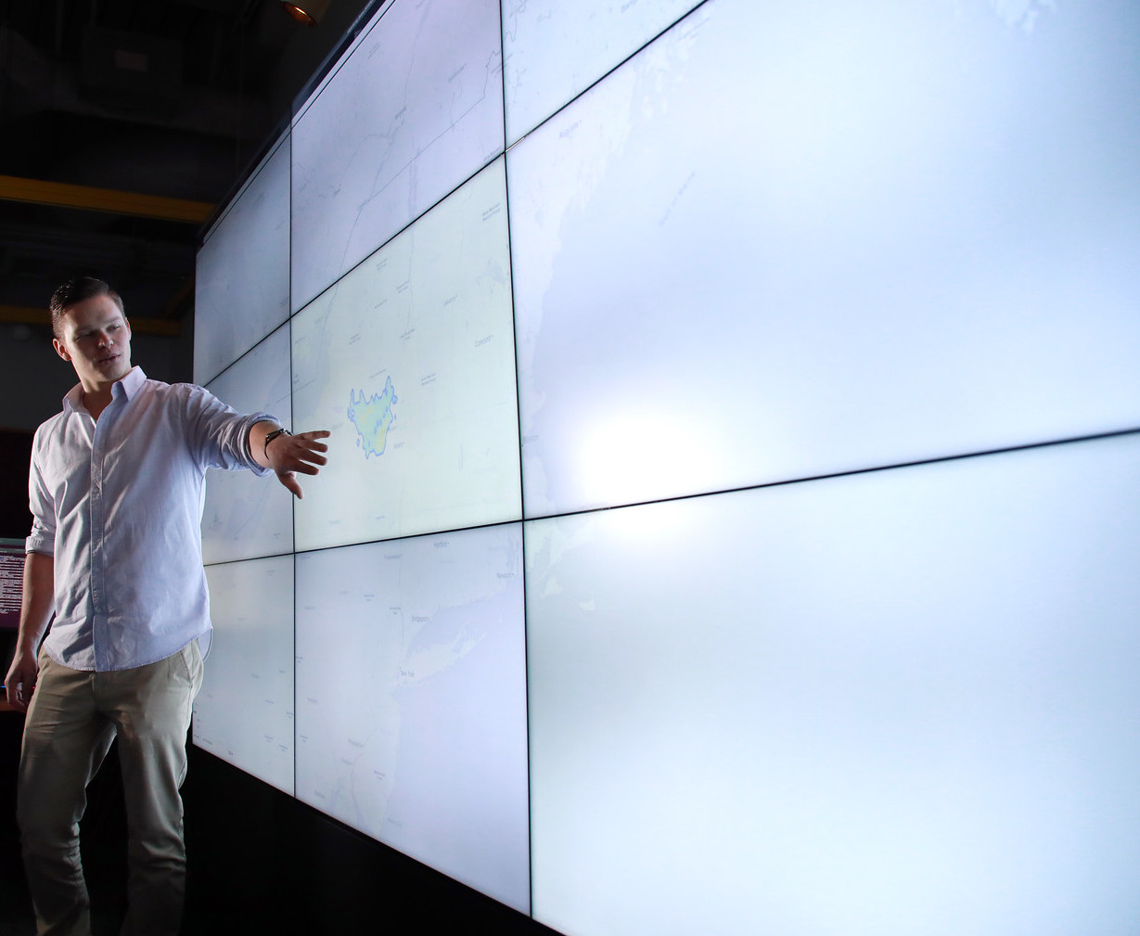
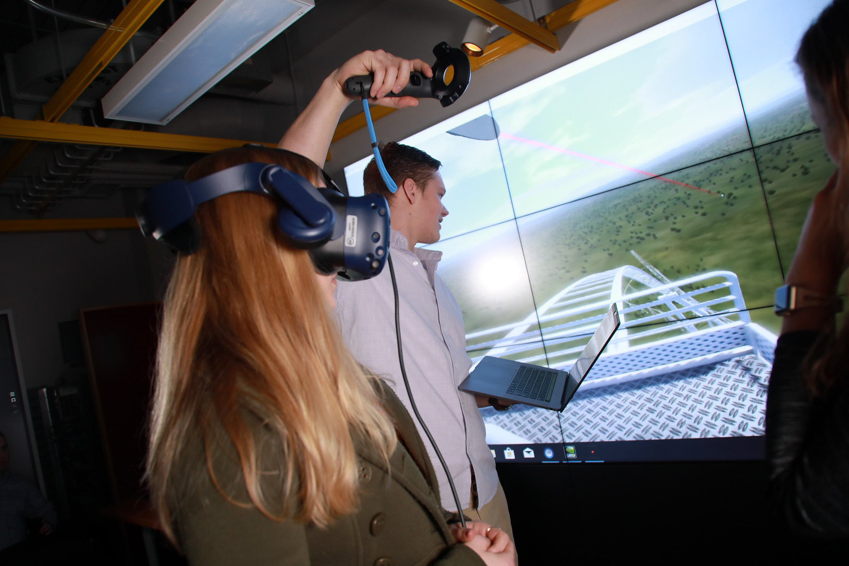
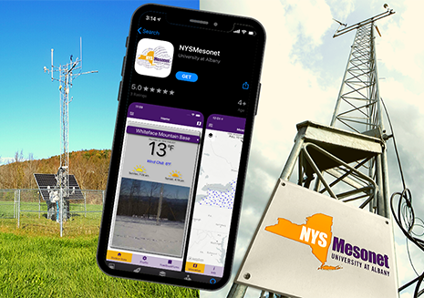
xCITE Laboratory
x4
FLASH STORAGE SERVER
High-speed SSD flash storage
121 TB
Dual Xeon CPUs
12 cores, 1.9 GHz
2 Dual-port networking cards
QSFP28 100GbE
128 GB RAM
HIGH-END WATER COOLED
LINUX SERVERS
1-3 Nvidia Titan RTX GPUs
24GB of GDDR6 graphics memory, 4608 CUDA enabled graphics cores, 72 Ray Tracing cores, and 576 Tensor cores
AMD Threadripper Processor
Ryzen series 4.2GHz 32-core
128GB 3600MHz DDR4 Memory
2TB NVMe Flash Storage
Mellanox ConnectX-5 100GbE NIC
x2
DATABASE SERVER
Single Xeon CPU
8 cores, 2.1 GHz
176 TB Raw Hard Drive Storage
RAID5
256 GB RAM
DGX-1 ARCHITECTURE ADVANCEMENTS
System Level Specifications
NVIDIA DGX-1 with Tesla V100
TFLOPS (deep learning) 1000
CUDA Cores 40,960
Tensor Cores 5,120
NVLink vs PCIe Speed-up 10X
Deep Learning Training Speed-up 3X
System Memory 1TB DDR4-2133
APPLICATION SERVER
Dual Xeon CPUs
16 cores, 2.1 GHz
128 GB NVMe SSD (OS)
16 TB Raw Hard Drive Storage
512 GB RAM
STORAGE
COMPUTE
VISUALIZATION
NAS STORAGE BACK-UP SERVER
RAID6
Single CPU
4 cores, 2.4GHz
96 TB Raw Hard Drive Storage
16 GB RAM

Slide 38
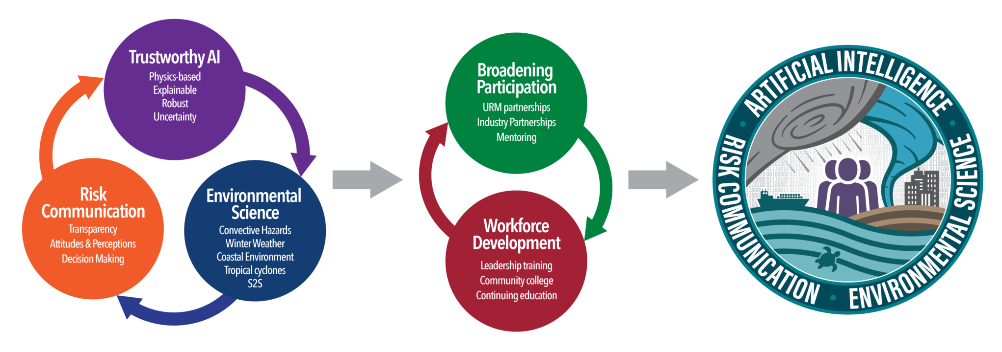
AI INSTITUTE: UALBANY Leads Winter Weather Use Case

Slide 39

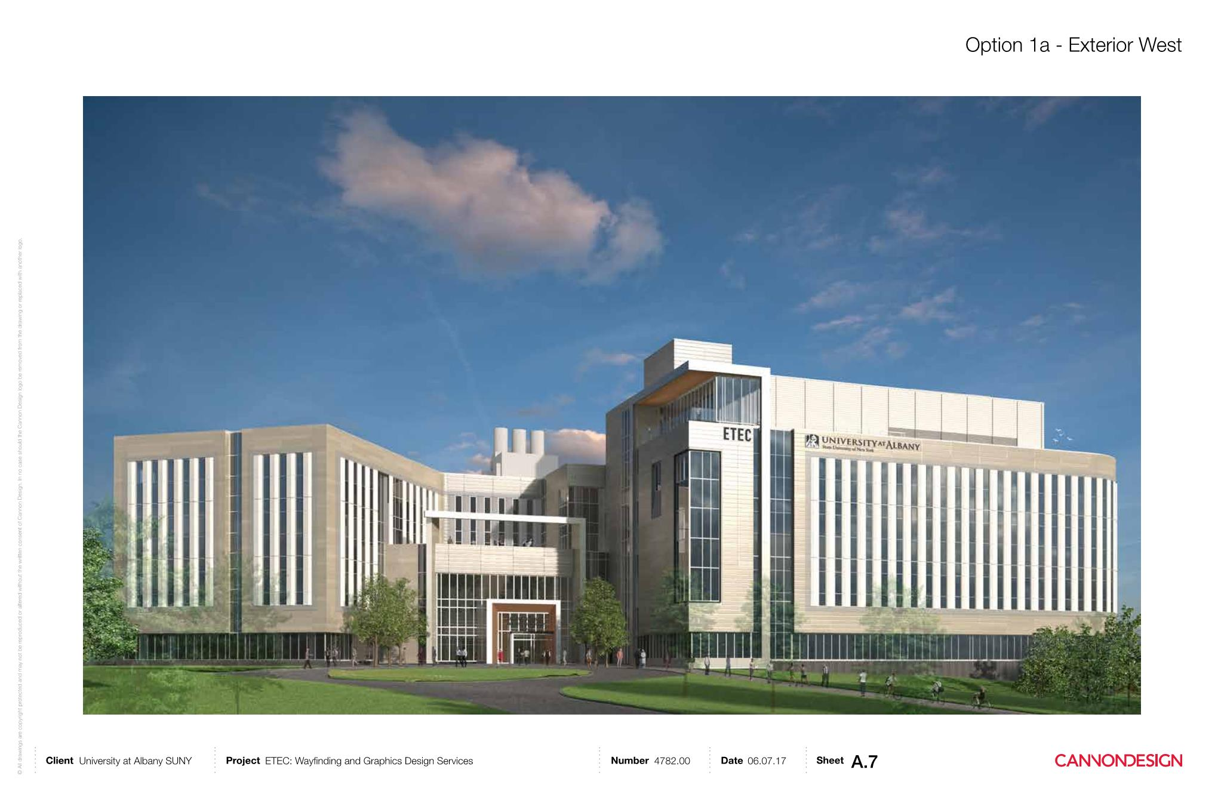
Building a State of the Art R&D Hub
$184M Emerging Technologies & Entrepreneurship Complex (E-TEC)
39

